Slide 1


PORTFOLIO PROJECT
Institute Of Emerging Careers
https://iec.org.pk/.
Confectionery sales Data
PRESENTED BY
Saima naz hussain
Palwasha khalid
Tayyaba

Slide 2
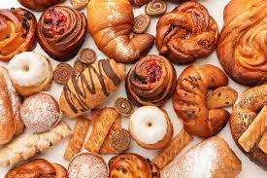
Business overview
Operating in New York State
8 Retail Outlets, 1 Warehouse, 1 Centralized HQ
Organized into 5 distinctive Product Groups
Monthly sales targets for each product group
01

Slide 3
Explore performance of specific outlets: Outlet 3, Outlet 5, and Outlet 8. In Month of April 2019.
Understand sales performance.
Analyze client distribution across generations.
Scope of the study
Stakeholders
Project stakeholders: Sales & marketing teams
02

Slide 4
OBJECTIVE
Determine success of sales goals for outlets 3, 5, and 8.
Identify reasons for both success and non-success.
Uncover factors behind achievements and shortcomings.
Study different client generations.
Gain insights for future sales strategies.
03

Slide 5
PROBLEM STATEMENT
Sales Performance Analysis / Sales Target:
Which sales outlets achieved their April quantity goals?
How did each sales outlet perform in meeting monthly sales goals across product group?
What are the top 10 products consistently purchased by repeat customers?
How can repeat-purchased products be categorized, and to which groups do they belong?
Which frequently repurchased items exist in each product group, and what's their group's total product count?
Client Generation Distribution:
How were clients distributed across different generation categories in April 2019?
What are the spans of each generation category and their average yearly customer count?
What's the average count of repeat customers per generation category?
04

Slide 6
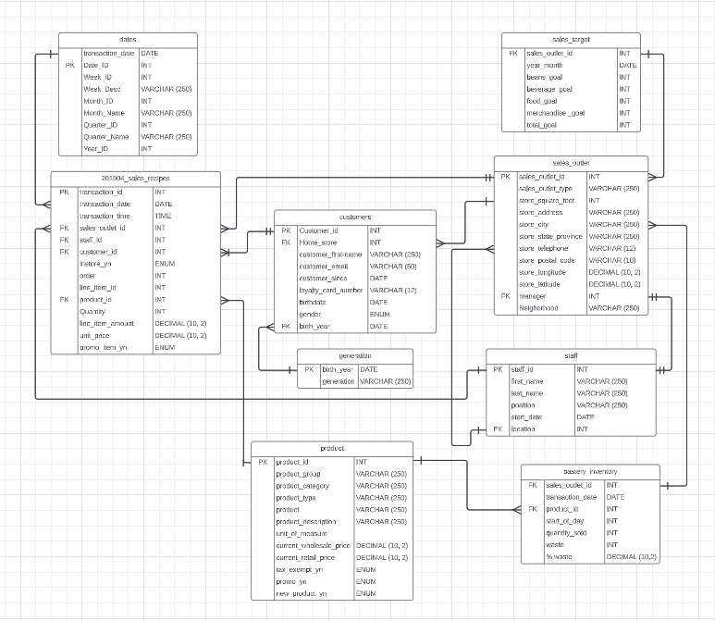
ERD
05

Slide 7
1- April Quantity Goal Status Across Sales Outlets
sales outlet id | total goal | quantity sold | status
3 | 18000 | 23620 | achieved
5 | 25000 | 24029 | not-achieved
8 | 22500 | 24109 | achieved
Outlet 3 and Outlet 8 successfully achieved their quantity goals, while Outlet 5 did not meet its goal.
Back to Agenda
06

Slide 8
2- April Quantity Goal Status Across Sales Outlets For Each Product Group
sales_outlet_id | product group | goal | quantity_sold | status
3 | beans goal | 720 | 313 | not-achieved
3 | beverage goal | 13500 | 20001 | achieved
3 | food goal | 3420 | 2489 | not-achieved
3 | merchandise goal | 360 | 94 | not-achieved
5 | beans goal | 1000 | 362 | not-achieved
5 | beverage goal | 18750 | 19282 | achieved
5 | food goal | 4750 | 2694 | not-achieved
5 | merchandise goal | 500 | 125 | not-achieved
8 | beans goal | 900 | 493 | not-achieved
8 | beverage goal | 16875 | 19822 | achieved
8 | food goal | 4275 | 2581 | not-achieved
8 | merchandise goal | 450 | 36 | not-achieved
05
Back to Agenda
07

Slide 9
2-April Quantity Goal Status Across Sales Outlets For Each Product Group
Beverage product group is the solo achiever of its quantity sold across all sales outlets.
other product group have fallen short of their targets.
Back to Agenda
08

Slide 10
3- Count of Products Purchased by Repeat Customers, Segmented by Product Groups
The number of products in each product group that were purchased by repeat customers indicates the potential for these products to encourage people to return for more purchases.
product_group | Count of product
Beverages | 41
Whole Bean/Teas | 21
Food | 11
Add-ons | 4
Merchandise | 3
Back to Agenda
09

Slide 11
4- Count of Products Purchased by Repeat Customers, Segmented by Product Groups
product group | total product in group | count of products purchased by repeated customers
Whole Bean/Teas | 21 | 21
Beverages | 47 | 41
Add-ons | 4 | 4
Food | 12 | 11
Merchandise | 4 | 3
Back to Agenda
10

Slide 12
5- Count of Products Purchased by new Customers, Segmented by Product Groups
Almost all of the available products were purchased by repeat customers. However, in the beverage group, only 6 products lacked repeat customers, and in the merchandise and food groups, there was 1 product each without repeat customers.
product_group | count of products purchased by new customers
Whole Bean/Teas | 0
Beverages | 7
Add-ons | 0
Food | 0
Merchandise | 0
Back to Agenda
11

Slide 13
6- Distribution of Customer purchases Across Different Generation Categories in April 2019
Almost all of the available products were purchased by repeat customers. However, in the beverage group, only 6 products lacked repeat customers, and in the merchandise and food groups, there was 1 product each without repeat customers.
year_range | generation | count of purchases
1950-1964 | Baby Boomers | 6019
1965-1979 | Gen X | 5691
1980-1989 | Older Millennials | 5474
1990-1994 | Younger Millennials | 3379
1995-2001 | Gen Z | 4289
Back to Agenda
12

Slide 14
7- Count of avg purchases by customers within each generation category
year range | span years | generation | Count of purchase | average purchases
1950-1964 | 15 | Baby Boomers | 6019 | 401.2667
1965-1979 | 15 | Gen X | 5691 | 379.4
1980-1989 | 10 | Older Millennials | 5474 | 547.4
1990-1994 | 5 | Younger Millennials | 3379 | 675.8
1995-2001 | 7 | Gen Z | 4289 | 612.7143
Back to Agenda
13

Slide 15
8- Avg Repeat customer In Each generation (after removing effect of unequal class intervel)
year range | span years | generation | no of customer | avg no of customer
1950-1964 | 15 | Baby Boomers | 529 | 35.27
1965-1979 | 15 | Gen X | 521 | 34.73
1980-1989 | 10 | Older Millennials | 515 | 51.5
1990-1994 | 5 | Younger Millennials | 298 | 59.6
1995-2001 | 7 | Gen Z | 382 | 54.57
14

Slide 16
RECOMENDATION
Sales Outlets Goal Achievement Analysis:
Outlet 3 and 8 achieved their goals, while 8 didn't.
Further analysis uncovers a key insight.
Success traced back to exceptional beverage group performance.
This success overshadowed weaker performance in other product groups.
Strategic Steps for Improvement:
Suggest more ambitious targets for the beverage group due to its success.
Emphasize the need to explore underperformance reasons in other product groups.
Uncover insights to address weaknesses and achieve balanced growth.
15

Slide 17
RECOMENDATION
Generation Category Distribution Analysis:
Currently most customers belong to the Baby Boomer generation.
Attributed to the class interval of Baby Boomer category.
Equalized class intervals reveal customer distribution.
Young Millennials and Gen Z show significant customer numbers.
Strong probability of Gen Z market size growth in the future.
Anticipate a decline in the Baby Boomer market.
Strategic Steps for Improvement:
Focus on future growth potential.
Highlight 'Gen Z' as a key market.
Emphasize their growing market size and purchasing power.
Suggest fostering brand loyalty through effective promotions.
16

Slide 18
RECOMENDATION
Recommend student-friendly deals and product trials.
Stress the importance of strategic decisions aligned with company goals
17

